Slide 1
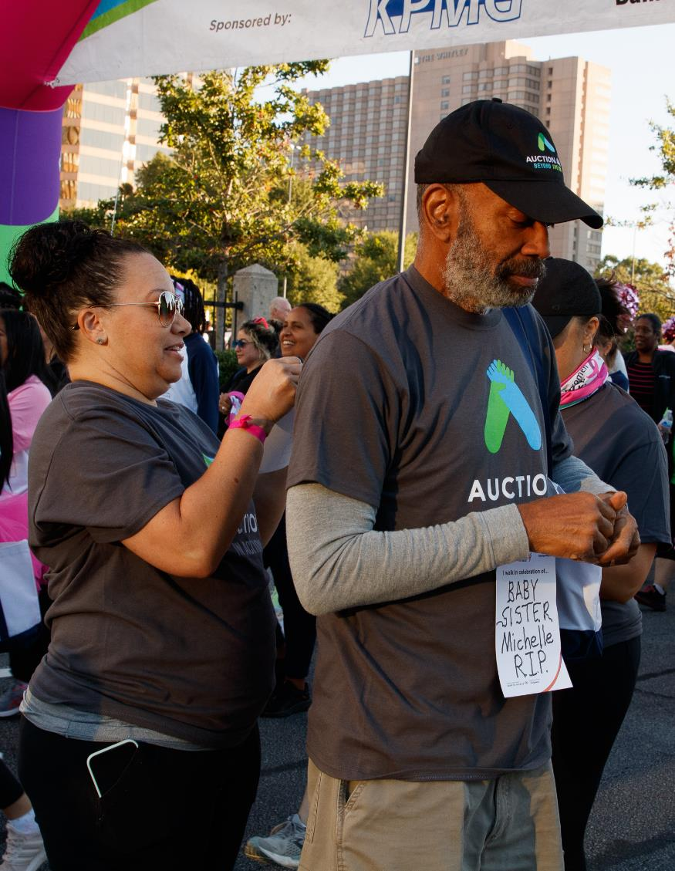

Team Kickoff
[Date]

Slide 2

Notes:
I’m Susan Wynne and so happy to be here to join you today. I think I have the best job in the world, as I get to work with companies like auction.com to help find ways to engage their employees in causes that matter to them. Like many of you, I have a personal connection to breast cancer, and got involved with Komen after I lost my best friend to metastatic breast cancer 16 years ago. Because of Komen’s research, she got more time with her young daughters and husband, and now, her girls who are now young adults, have much better treatment options should they ever receive a breast cancer diagnosis.

Slide 3

Welcome
Executive
Sponsor
Photo
[Name]
[Title]
[Team Name] Executive Sponsor

Slide 4
Your Team Champions
Champion
Photo
[Champion Name]
[Title]
[Team Name] Champion

Slide 5
Misson Moment
Ambassador / Survivor
Photo
[Ambassador Name]
[Title/Department/Region, etc]

Slide 6
Susan G. Komen Staff Partner
SGK Staff Photo
[SGK Staff Name]
[Title/Department/Region, etc]

Slide 7
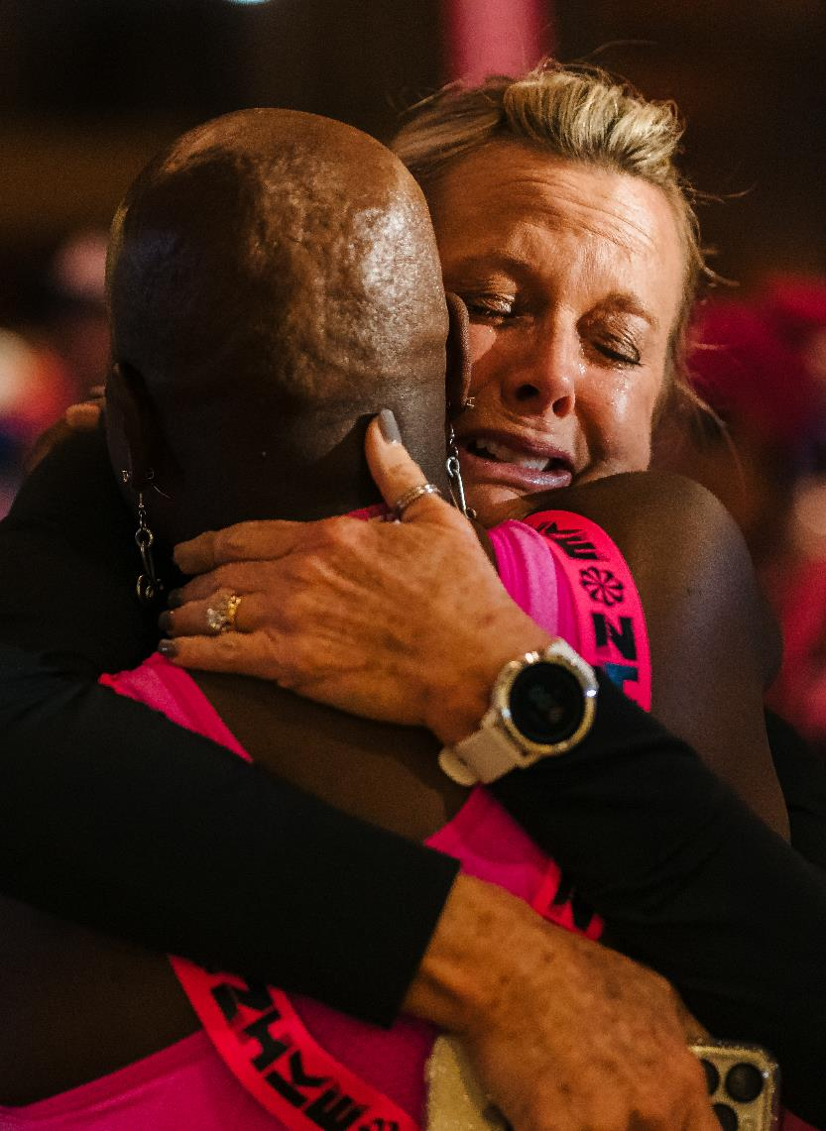
About Susan G. Komen
Komen is the leading breast cancer organization and as the trusted health care guide for breast cancer. Komen is dedicated to supporting the breast cancer community by accelerating research, expanding our impact on public policies through advocacy, providing direct patient services that address the economic, medical, social and emotional (psychosocial) impact of a breast cancer diagnosis, and advancing health equity for all dealing with breast cancer.

Slide 8


Breast Cancer Facts
The most significant risk factors for breast cancer are being a woman and getting older.​
Every 12 minutes, one woman in the U.S. will lose her life to breast cancer.​
African-American women in the U.S. die from breast cancer about 40% more than Caucasian women.​
Breast cancer is the leading cause of cancer deaths for all Hispanic women in the U.S.​
Breast cancer treatment can cause financial strain that forces patients to choose between their health and other needs.

Slide 9
Our Strategic Imperatives
Conquer aggressive and deadly breast cancers to help people live longer, better lives.
Ensure all people get the care they need and achieve health equity
Achieving health equity is core to Komen’s mission. Komen is committed to eliminating breast cancer disparities by breaking down the barriers that create poor breast health outcomes through a variety of proven interventions. By collaborating with communities, policymakers, researchers, health care workers and other key stakeholders to help create a world where everyone has a just opportunity of surviving breast cancer.
Susan G. Komen has long been committed to doing everything we can to eliminate breast cancer and research is key to finding new discoveries and treatments for aggressive and deadly breast cancers. That is why we are committed to advancing research for metastatic breast cancer, inflammatory breast cancer, triple negative breast cancer and all rare, deadly and aggressive breast cancer communities.
Notes:
To achieve our mission, Komen is focused on two strategic imperatives that highlight broad needs Komen is focused on to achieve our mission:
The first is to “conquer aggressive and deadly breast cancers to help people live longer, better lives.” This work directly affects those living with metastatic or stage 4 breast cancer and those who experience an unexpected late-stage diagnosis or recurrence.
The second strategic imperative is to “ensure all people receive the care they need and achieve health equity.” Here we are working on initiatives that help people overcome barriers that result in breast cancer disparities. For example, Black women in the US are about 40% more likely to die of breast cancer than their white counterparts. Disparities also exist with the Hispanic and Latino/a community, LGBTQ+ community and people in rural communities, for example, so we design our work with the understanding that specific communities need additional help and care.

Slide 10
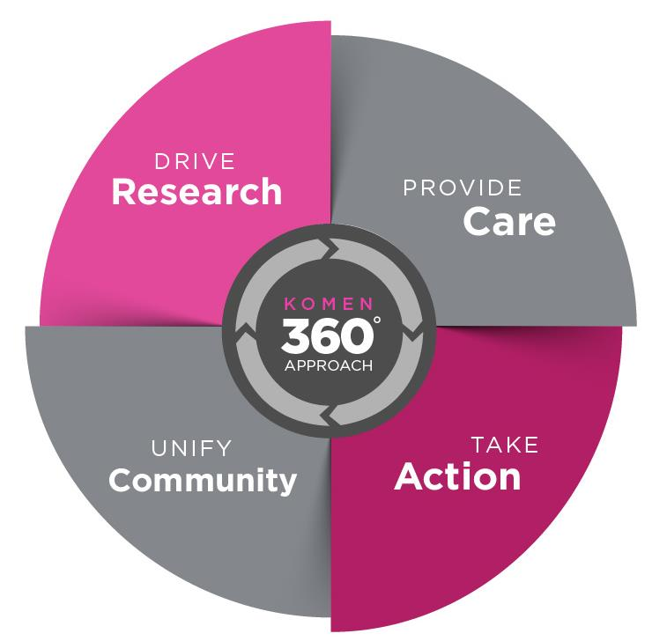
Our 360 Degree Approach
Komen is the only breast cancer organization taking a comprehensive, 360-degree approach to fight breast cancer across all fronts, supporting millions of people in the U.S. and worldwide.

Slide 11




Our 360 Degree Approach
DRIVE RESEARCH
Guided by world renowned experts, we evaluate and invest in science and technology that will provide the greatest benefit to patients.
PROVIDE CARE
We serve as a trusted breast health care guide by providing evidence-based education, personalized support and connection to timely, high-quality care.
TAKE ACTION
We mobilize people to advocate for policies that protect patients, prioritize research and create lasting systemic changes to improve outcomes for all.
UNIFY COMMUNITY
We unite communities that are bonded by a common interest and come together to deliver a greater impact in ending breast cancer.
Notes:
While other breast cancer organizations focus on a narrow aspect of the fight, Komen stands alone in the breadth of its work and its ability to impact millions of people annually. Komen is the only breast cancer organization taking a comprehensive 360-degree approach to fight breast cancer.
I want to highlight some of our recent accomplishments that spotlight the work we’re doing in these areas:
-Established an entirely virtual patient care center and provided over 100,000 services to people across the country, including patient navigation, emotional support, referrals to local resources, financial assistance, and more
-Educated millions of individuals about breast cancer risk, screening, diagnosis and treatment where they live, work, play and pray
-Invested $100 million in research, including for 176 research grants and 59 clinical trials focused on conquering metastatic and aggressive breast cancers, advancing personalized breast care, and eliminating breast cancer disparities to save lives
-Developed and launched ShareForCures, a national “direct-to-consumer” breast cancer research registry, which aims to be the most inclusive, diverse real-world database available to accelerate research progress
-Created the Center for Public Policy to expand volunteer advocacy efforts in support of policies that protect patients’ access to high quality care and alleviate financial burden.

Slide 12
Our Team Goal
$XXX,XXX

Slide 13

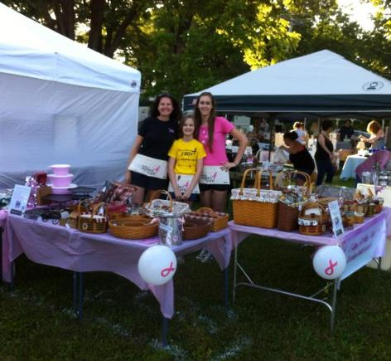

What’s Next?
Register
Fundraise
Celebrate

Slide 14
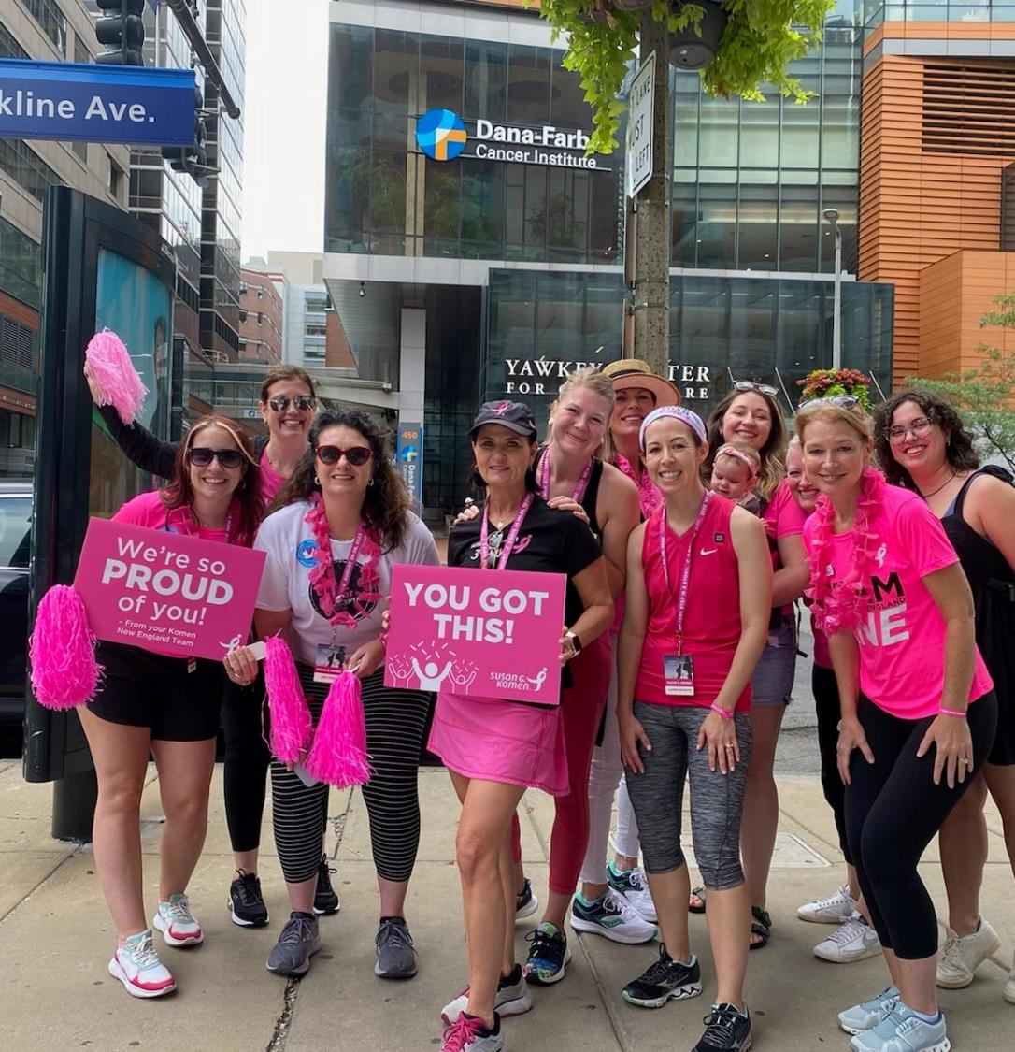
Get Registered!
[insert all registration information, links, QR codes, events, etc]
Irvine Pacers
Orange County MORE THAN PINK Walk
Atlanta Pacers
Georgia MORE THAN PINK Walk
Don’t forget to invite your friends and family to register!

Slide 15

Company Motivators and Incentives
Coffee gift card for every team member that starts fundraising
Company team t-shirt for fundraisers that reach the $100 level
Restaurant vouchers for fundraisers that reach the $500 level
CEO-hosted lunch for all fundraisers who reach the $1,000 level
Prime parking/gas gift card for team captains with 100% fundraising participation from their team members
Paid time off for fundraisers who reach the $2,500 level
Voucher to shop in the company store
Traveling trophies for top fundraising team, best theme, most creative fundraiser, etc.
Company match for employee donations
Company donation for steps walked leading up to the Race for the Cure® or MORE THAN PINK Walk®

Slide 16
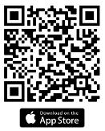
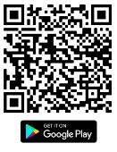

Fundraising in 5 Easy Steps
Set your personal goal.
Consider making a personal donation to kickoff your fundraising show your donors you are invested too! Then challenge your friends and family to match your donation.
Personalize your fundraising page and tell everyone why you are participating.
Download the apps for your events (MORE THAN PINK Walk, SGK Race, Susan G. Komen 3-Day). Participants who use our apps raise 7 times more than those who don’t!
Start a Facebook Fundraiser right from your fundraising center or from the app.
Notes:
we know, that even if you’re a pro fundraiser or have never fundraised before, that if you do these things you’ll set yourself up for success!
Set your personal goal or share what you’ve already raised. A goal gives you something to reach for while fundraising. You can measure your progress against this amount and celebrate your accomplishments! If you reach the goal, you can always raise it and work toward a new target.
Make a personal donation to kick-off your fundraising and encourage your friends and family to match it. It shows your commitment and investment in the cause and sets a great example for teammates and donors!
Download the apps (MORE THAN PINK Walk, SGK Race, Susan G. Komen), this is a great tool that you can use to easily reach out to your contacts and ask for donations, thank your donors, and keep track of all your progress! The app helps you fundraise on-the-go and track your progress, as well as track your steps as part of the race and walk community and learn more about our mission to end breast cancer and earn badges along the way!
You can set up a Facebook fundraiser from your fundraising page or the app! Connecting your fundraiser to Facebook is a great way to maximize your fundraising, and participants who do raise 10x more! The progress on your Facebook Fundraiser will stay in sync with the progress on your fundraising page. Invite ALL of your friends on Facebook, even those that you don’t interact with regularly and make sure to share the fundraiser on your page regularly
And finally, One of the most compelling ways to show your commitment is by sharing a story on your personal fundraising page. Whatever brought you to the More Than Pink Walk your story is unique. Your WHY is an important way for you to share your message with potential donors. Give us a peek into what made you decide to participate and fundraise. Give yourself permission to share as much or as little as you want. When we share our own experiences, it brings others into your world and inspires them to take action too!

Slide 17
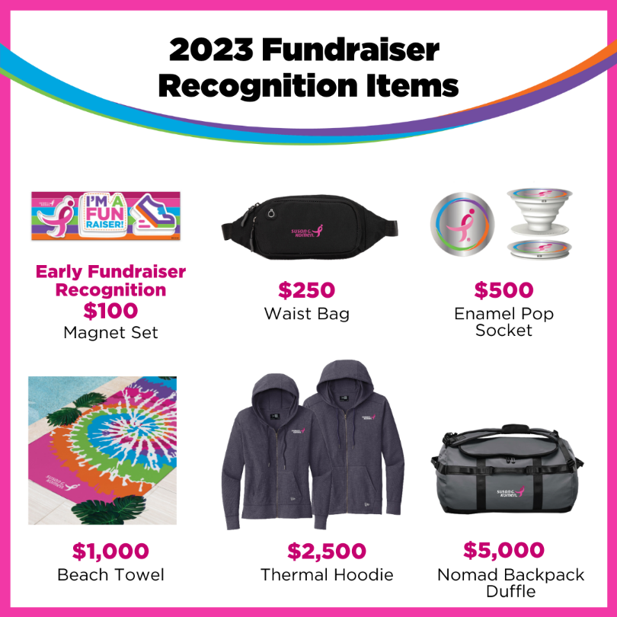
Fundraising Recognition
Top Fundraisers ($1,000)
Top Teams ($2,500+)
Fundraising for a T-shirt
  Everyone who raises $100 or more will receive an event t-shirt.

Slide 18
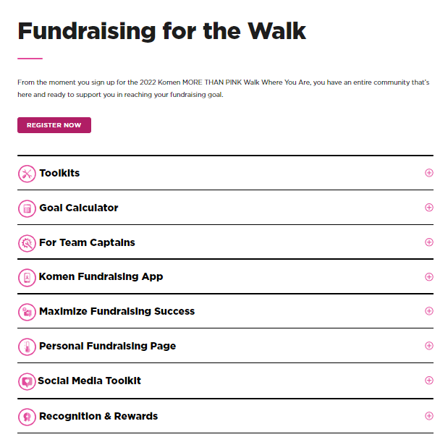
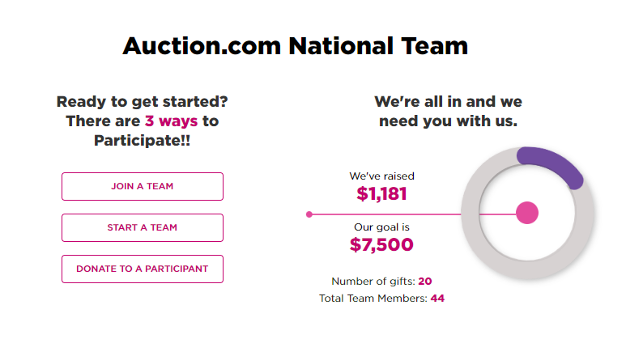
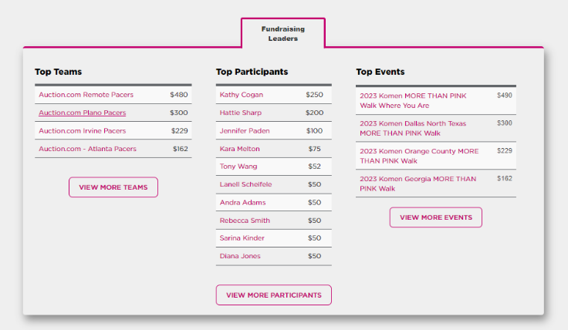
Fundraising Tools
Visit here often to check our progress and see current leaderboards
Notes:
We have a wide variety of tools that you can access to help you fundraise. The information you see here can be found on your event’s website under the “Fundraise for the Race or walk tab” I want to call out the social media toolkit specifically, where you’ll find template posts that you can just copy and paste or customize as well as images that can be shared on any social platforms you use.

Slide 19

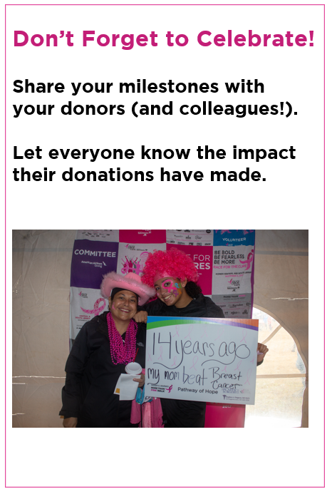

Notes:
The funds you raise through your team allow us to do the serious and impactful work we do each and every day, but that doesn’t mean we can’t have fun and celebrate all we accomplish along the way.
Your coworkers will be your biggest cheerleaders, and will be excited to celebrate all the milestones, big and small! So speak up and brag a little! You know you want to!
Don’t forget to celebrate with your donors as well. Use our fundraising tools to share the impact their donations will have on our Mission.

Slide 20
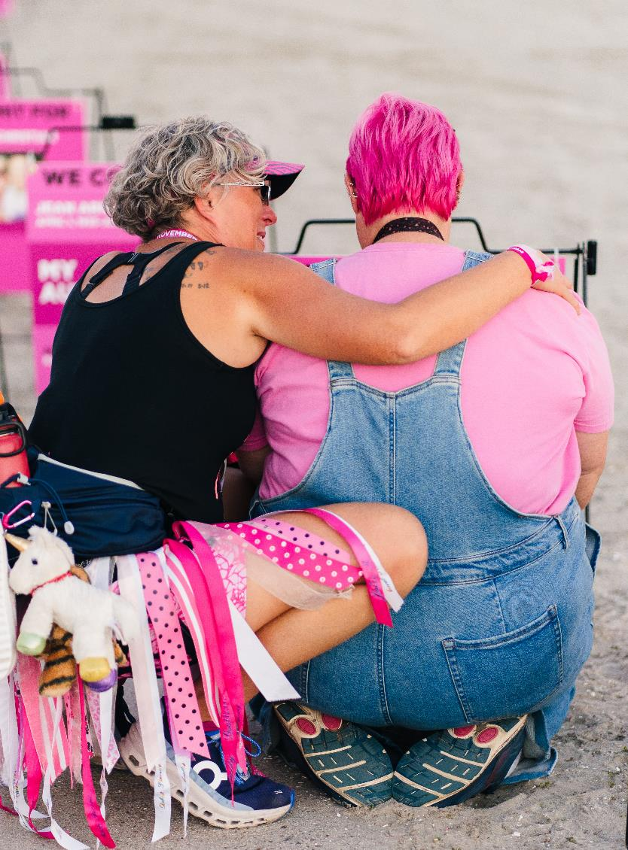
Thank You and Next Steps
[insert next steps, link reminders, etc]
Register at [Team Link]
  (By this Friday, XX to qualify for the registration challenge!)
Invite friends and family to join us
Start your Facebook fundraiser
Download the app
  GET READY TO HAVE FUN!
Notes:
We’re so excited to get started, and we hope you are too. Here’s the QR codes for each team again so that you can get registered.
If you haven’t already, your first step is to get registered. You can visit the link here, or scan the QR code to register from your phone in a few easy steps.
Once you’ve registered yourself, ask your friends, family, neighbors and co-workers to join you! Teams are at the core of the More Than Pink Walk events, and through your participation you will help build community and raise funds vital to furthering our mission.
We’re so proud to work alongside each of you and can’t wait to see all that we’re able to accomplish together.

Slide 21
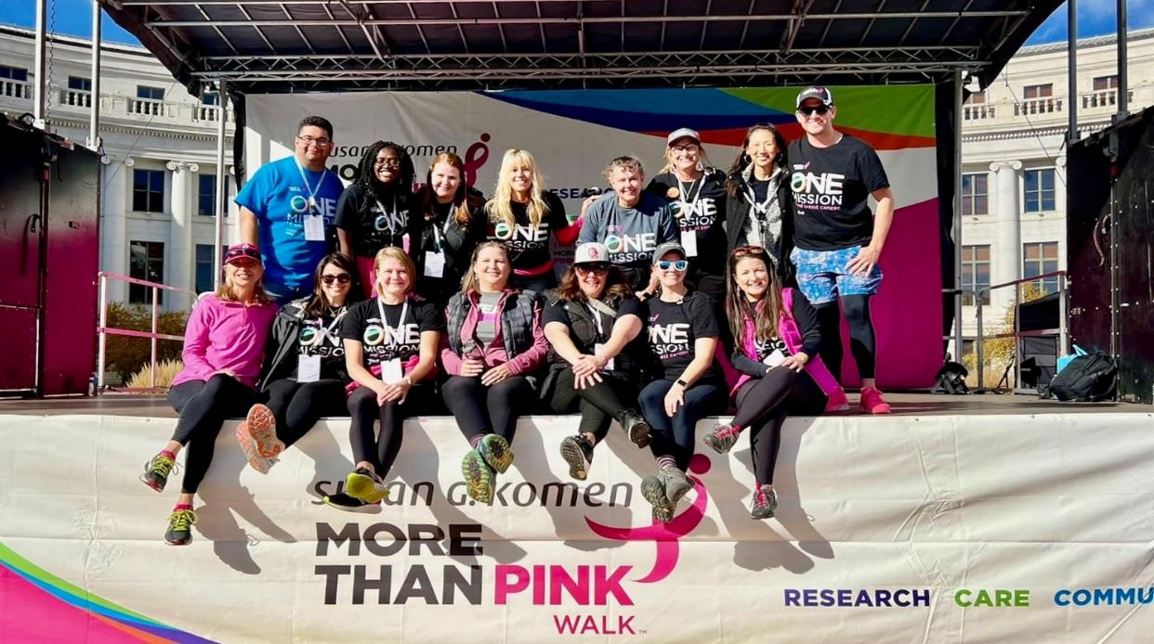

Q&A
?

